Slide 1
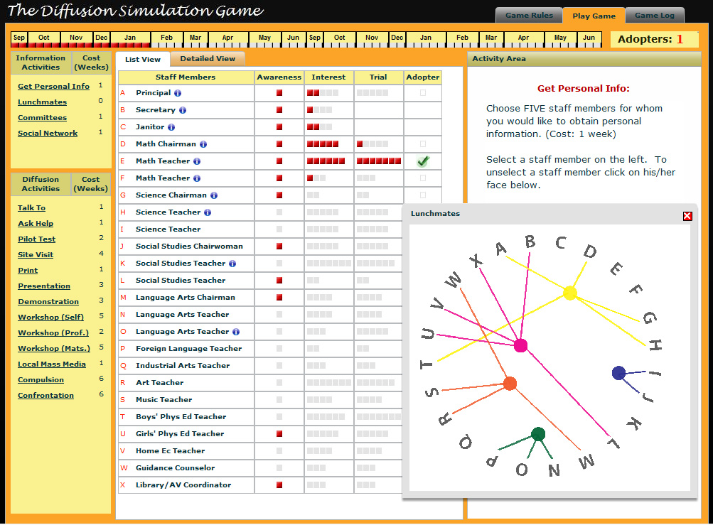

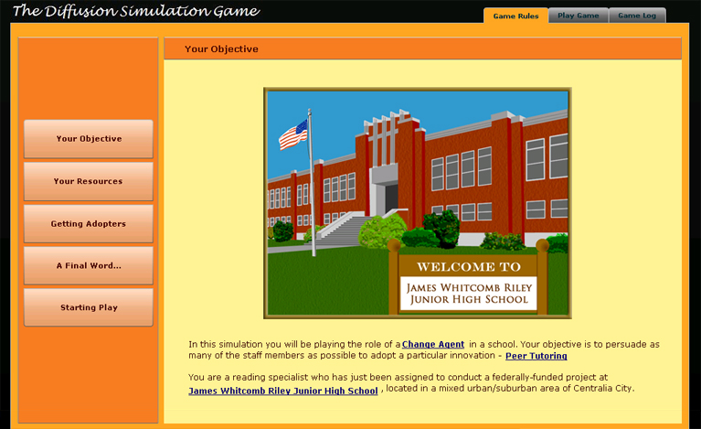
The Diffusion Simulation Game
Approaches to Studying Online Games for Learning

Slide 2
SimEd Research Team
Faculty Mentor: Ted Frick
Ph.D. Student Research Team
Jake Enfield
Seolim Kwon
Miguel Lara
Rod Myers
Tzu-Feng (Brian) Wu
Department of Instructional Systems Technology
School of Education, Indiana University Bloomington
Notes:
Ted

Slide 3
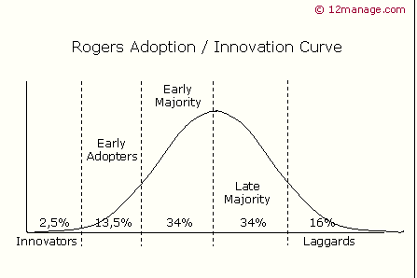
Background
Diffusion of Innovation Theory (Everett Rogers)
Source: http://www.12manage.com/methods_rogers_innovation_adoption_curve.html

Slide 4
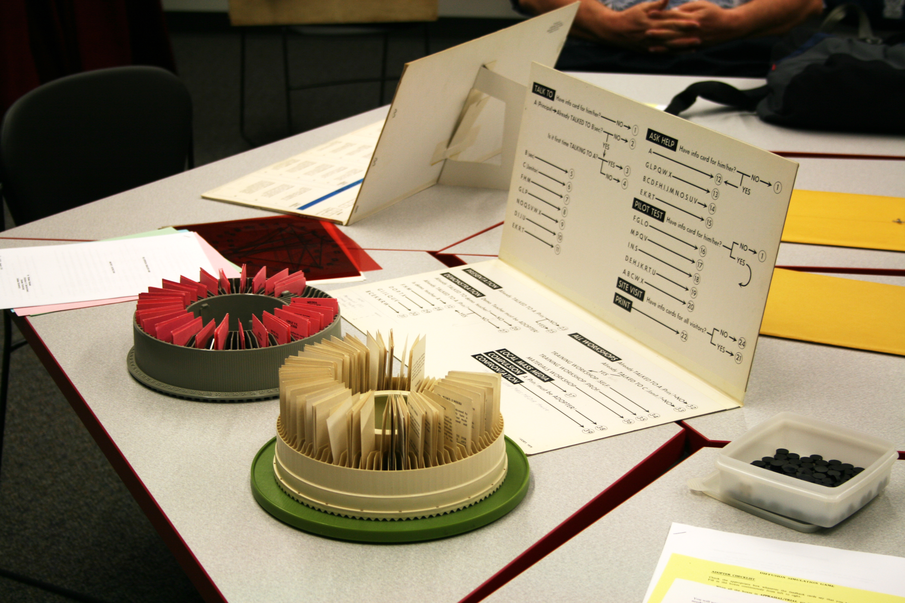
The Board Version
Notes:
The board version was developed by Dr. Molenda and a graduate student, Patricia Young in the 1970’s. It has been used in the IST master’s curriculum since that time until we started our distance program. When our distance master’s program started we needed an online version. Dr. Frick led an advanced production class to create the current online version.

Slide 5
The 1st Online Version https://www.indiana.edu/~simed/istdemo
Notes:
Over 3,500 students have played the licensed version of the DSG at Indiana University in the past 7 years.
Users from around the world have played the free version about 12,000 times since Nov., 2007.
IST has sold about 350 licenses for the full version in the last 3 years.

Slide 6

DSG Version 2.0: Is this familiar?

Slide 7

Demo of DSG new version (beta)
Notes:
Miguel

Slide 8
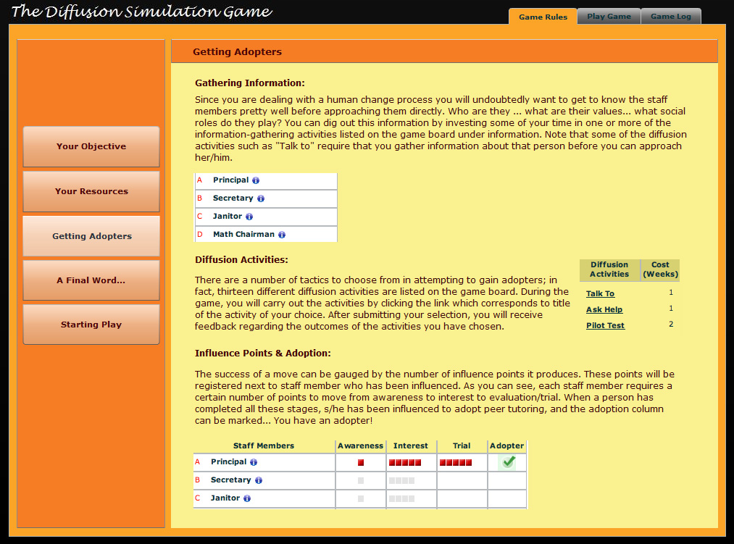
Notes:
Miguel

Slide 9
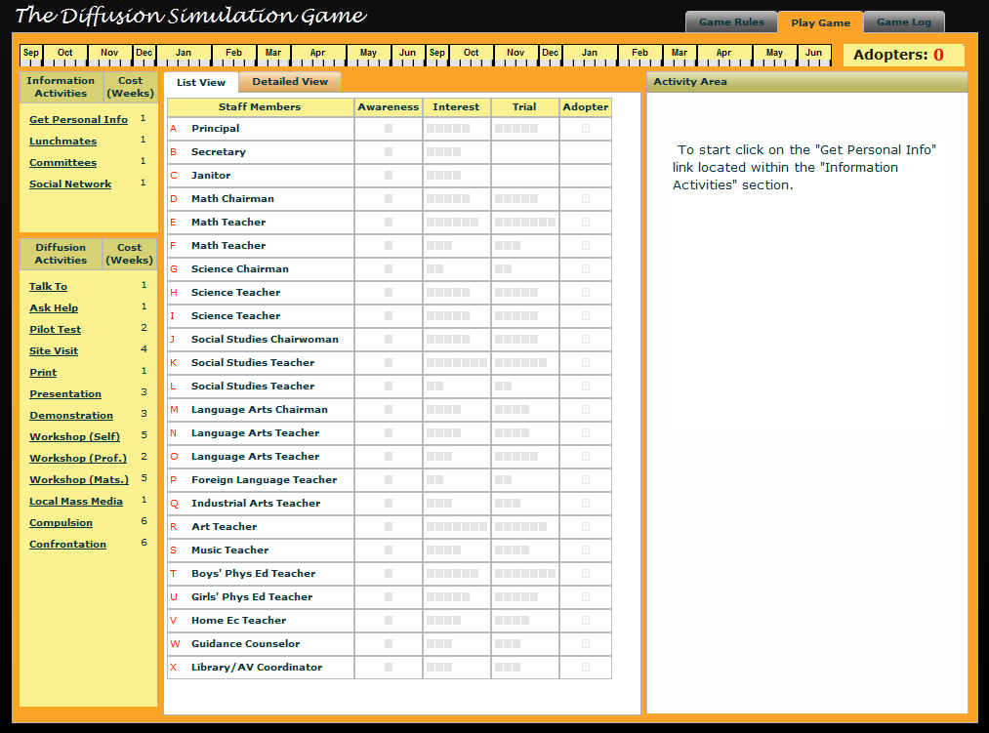
Notes:
Miguel

Slide 10
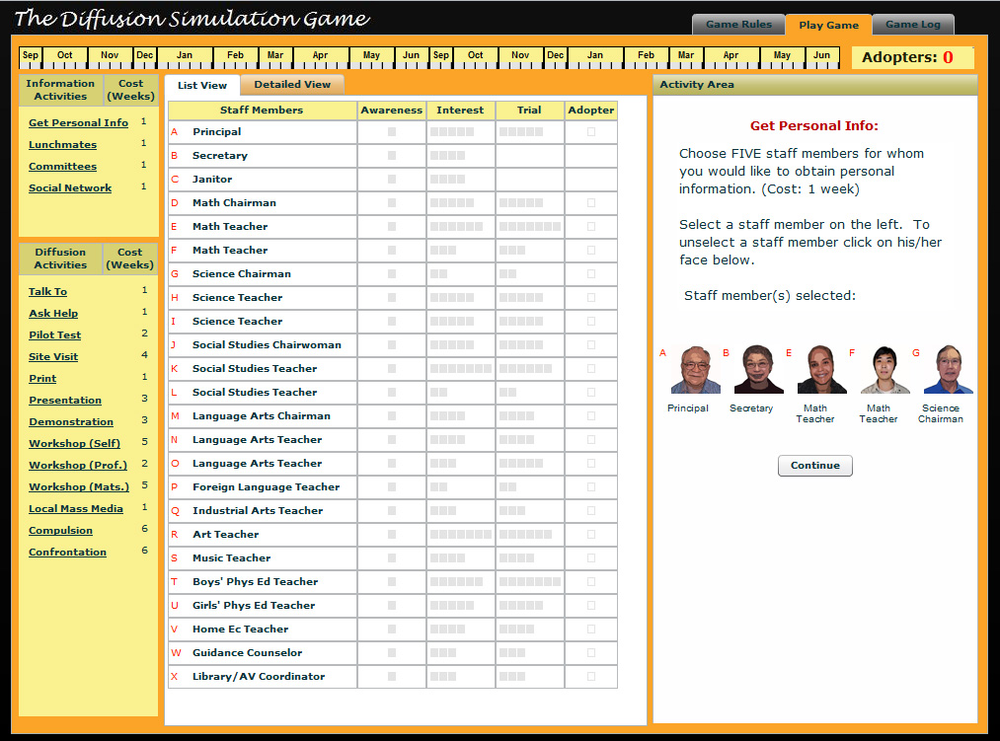
Notes:
Miguel

Slide 11
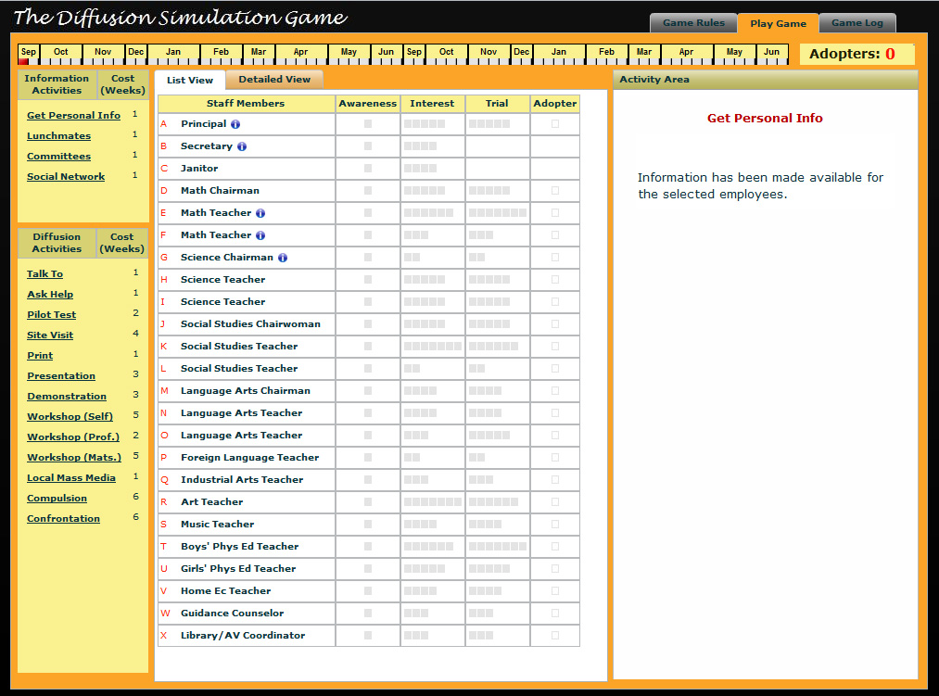
Notes:
Miguel

Slide 12
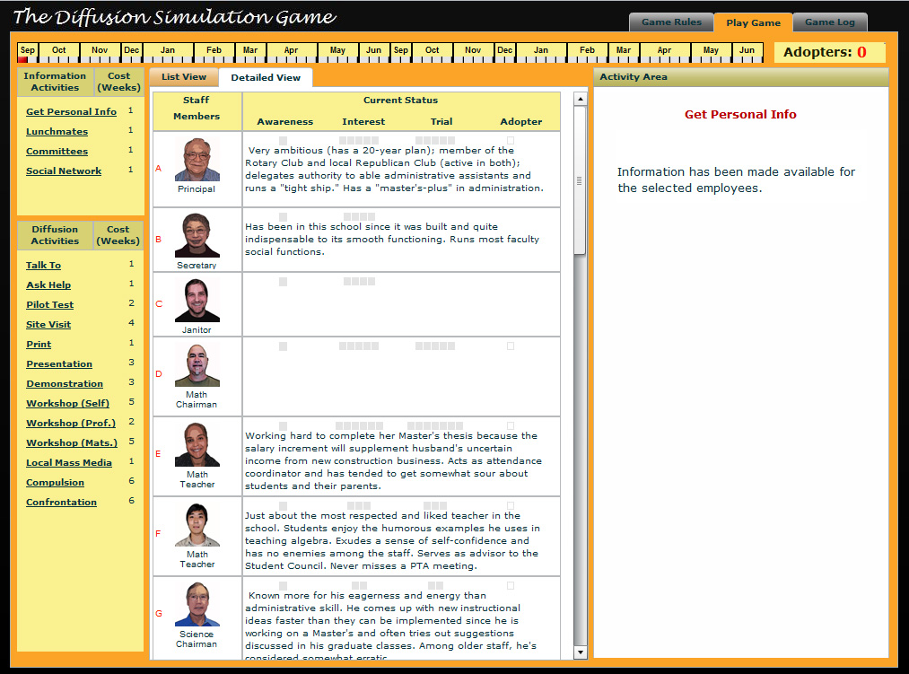
Notes:
Miguel

Slide 13
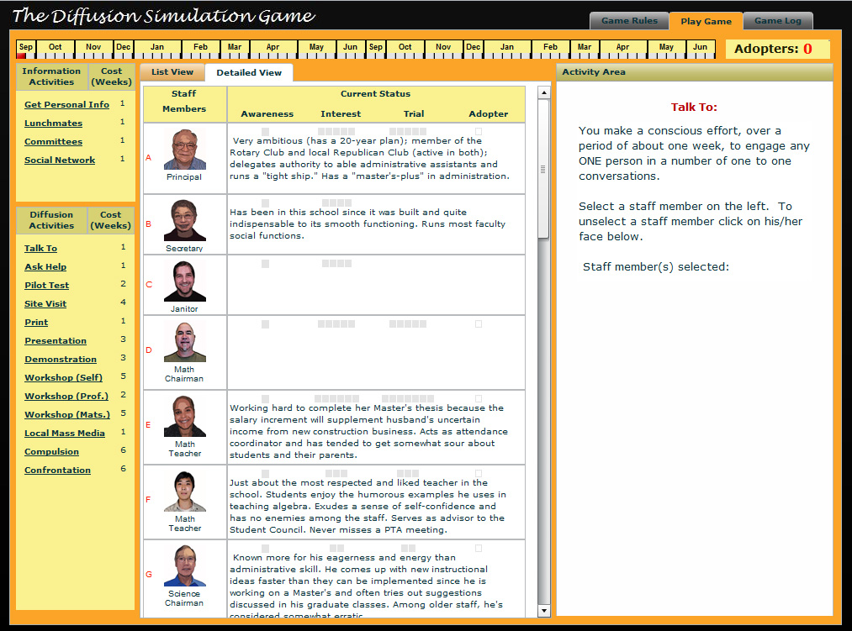
Notes:
Miguel

Slide 14
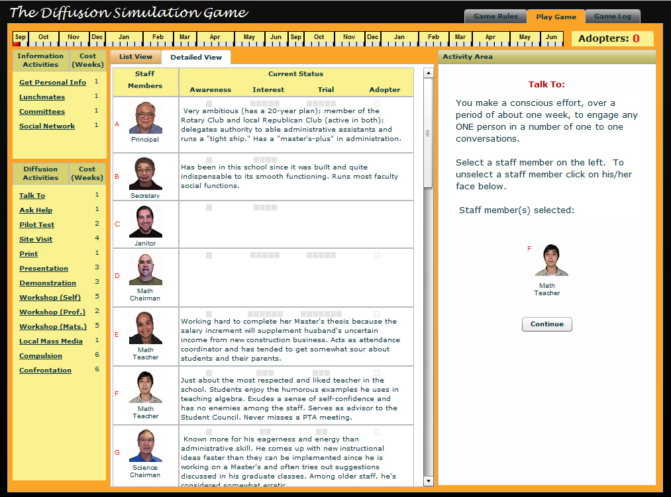
Notes:
Miguel

Slide 15
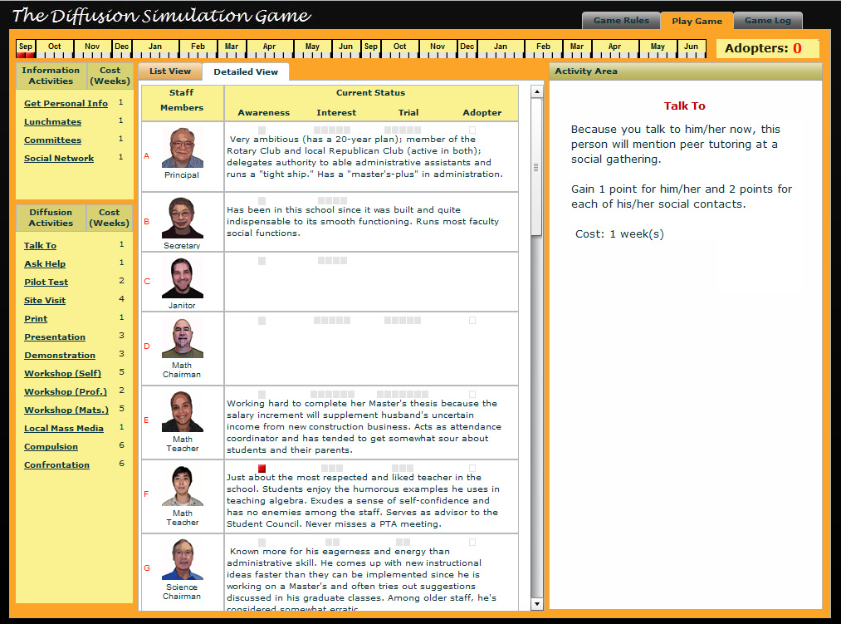
Notes:
Miguel

Slide 16
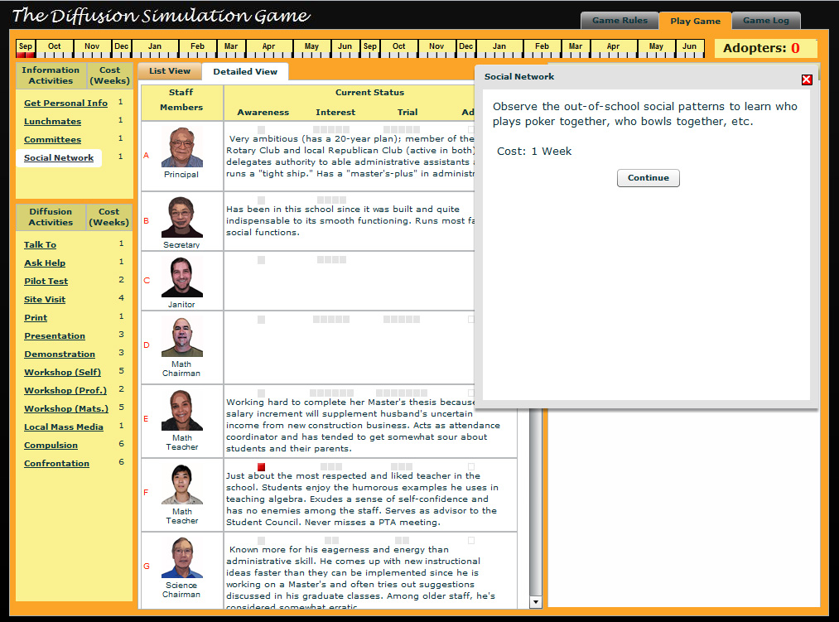
Notes:
Miguel

Slide 17
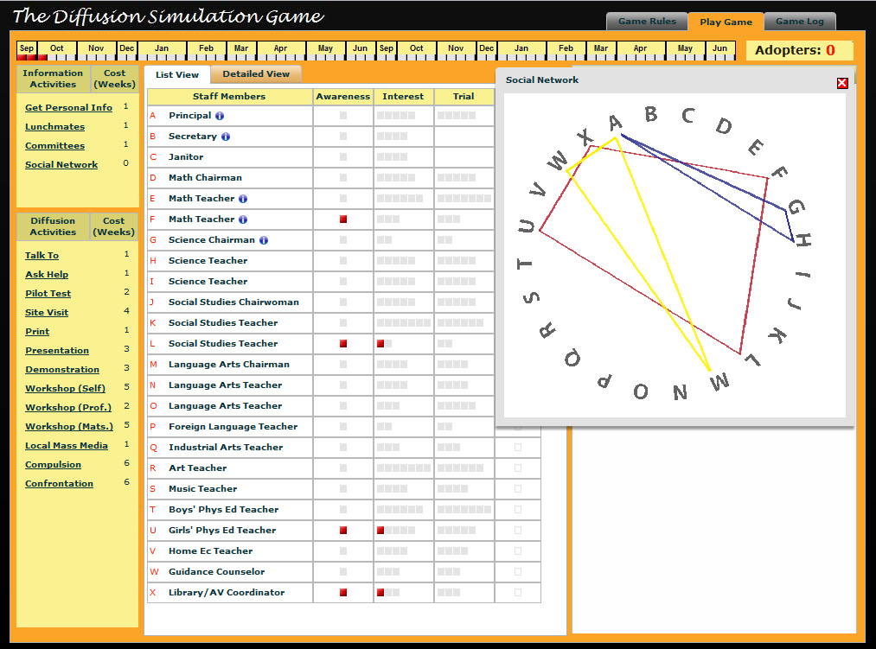
Notes:
Miguel

Slide 18
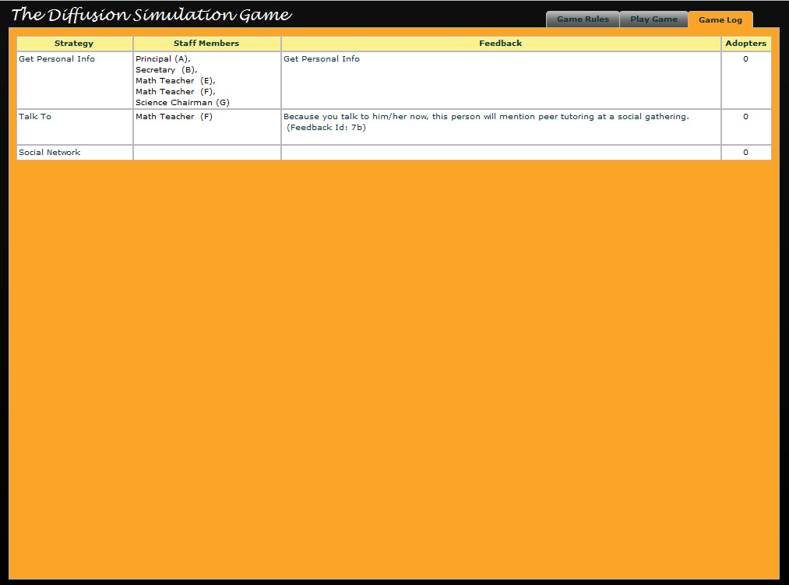
Notes:
Miguel

Slide 19
Ongoing DSG
Research Studies
Jake Enfield, Miguel Lara, Rod Myers, Tzu-Feng (Brian) Wu, Seolim Kwon

Slide 20
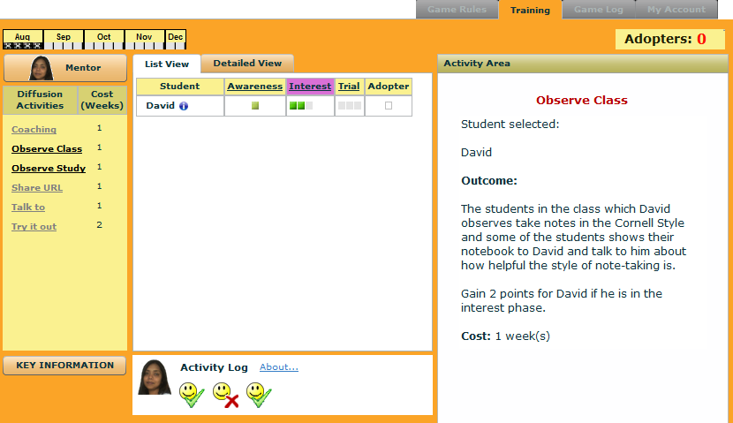
Jake Enfield’s Study
Redesigned to reduce cognitive load of learners
Levels: each level represents an increasingly complex mental model.
Objectives within Levels: provide variety of contexts and decreasing amount of Instructional Support.
Instructional Support: consists of Supportive Information (for learning the mental model provided at beginning of each level) and Just-In-Time Information (for procedural learning).
An Investigation of the Application of the
Ten Steps to Complex Learning to an Educational Game
Purpose
To explore the application of the Ten Steps to the Instructional Design of educational games which have complex learning objectives in order to identify potential improvements that can be made.
Research Questions
1. How could the Ten Steps have been more useful in re-designing the DSG to be appealing to the players who participated in this study?
2. How could the Ten Steps have been more useful in re-designing the DSG to be effective and efficient to the players who participated in this study?

Slide 21
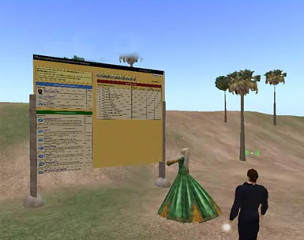
Miguel Lara’s Study
Personality traits and performance in online game-based learning: collaborative versus individual settings
Purpose
This study integrates three main areas (Computer-Supported Collaborative Learning, Personality psychology and Game-based learning) to explore the relationship between personality traits on learning, performance, and attitude when playing an online instructional simulation game individually versus playing it in dyads following a collaborative script.
Research Questions
Is there any difference in game performance, learning and
attitude between students playing an online instructional
game individually versus playing it collaboratively in dyads?
What are the common personality traits of the top achiever players in each setting?
What is the relationship between the level of Agreeableness and performance, learning and attitude in students playing an online instructional game in dyads?
Are there any common patterns in the game play strategies used by students within each setting?
DSG redesigned version
Elements were reduced by half. It’s using Second Life’s co-browsing feature to allow multiple players.

Slide 22
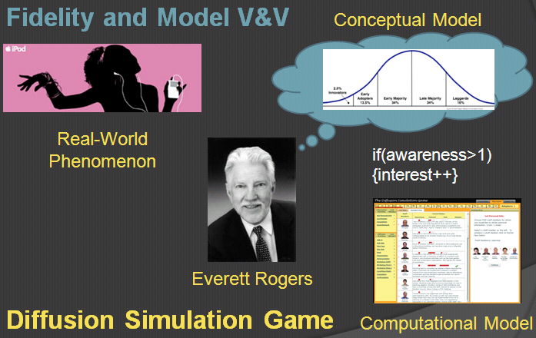
Rod Myers’ Study
Analyzing Interaction Patterns
to Verify a Simulation/Game Model
Practical question
How can simulation game designers verify that gameplay results based on the computational model are reasonably accurate with respect to the conceptual model?
or
How do we know we built it right?
Research questions
Is the proposed method effective in verifying the accuracy of computational models created for simulations and games?
What does the proposed method contribute that is not available through related methods?
What improvements can be made to the proposed method?
Approach
Formulate game strategies that should be successful based on Rogers’ theory
Query for gameplay patterns that instantiate those strategies
Analyze relationship between patterns and game scores

Slide 23
Brian Wu’s Study
Will signaling used in serious games help learning?
What is signaling?
“When it is not feasible to remove all the embellishments in a multimedia lesson, cognitive load can be reduced by providing cues to the learner about how to select and organize the material—a technique called signaling” (Mayer & Moreno, 2003).

Slide 24
Study purpose
Signaling can help guide what learners pay attention to and can help them mentally organize key material (Mayer, 2009).
Signaling has positive effects for learning under certain conditions.
There have been few studies examining the effectiveness of signaling in games for learning.

Slide 25
Research questions
Can the use of signaling in the DSG help players pay attention to important information without any prompt or hint from another person?
Can player’s game performance on DSG improve with the use of signaling?
Can DSG with signaling help players learn to apply the concepts of Diffusion of Innovation Theory better than DSG without signaling does?

Slide 26
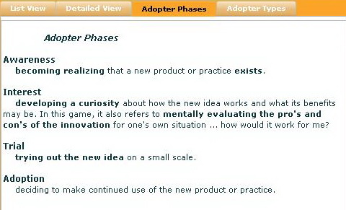
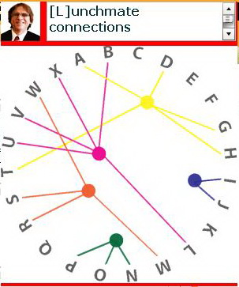
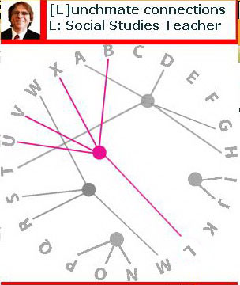
Type of signaling used
Typographical signaling: Bolding text
Visual signaling: “Grayout” image

Slide 27
Research design
Ask each participant to fill out the background survey before the study.
Each participant takes the pre-test.
Teach each participant the rules of the Diffusion Simulation Game.
Each participant plays the DSG. The participant’s game performance and voice describing the moves will be recorded using screen capture software.
Each participant takes the post-test.
Each participant fills out the game experience survey after post-test

Slide 28
Conclusion
Treatment group (with signaling) made better improvement in the test than control group did (without signaling), but the difference is not significant (t score is -0. 191).
No difference between control group and treatment group in game performance (t score is 0.713).
Group Statistics
 | Group | N | Mean | Std. Deviation | Std. Error Mean
score | C | 5 | 2.0000 | 1.41421 | .63246
 | T | 5 | 3.4000 | 1.67332 | .74833
Group Statistics
 | ID | N | Mean | Std. Deviation | Std. Error Mean
Score | T | 5 | 14.6320 | .86364 | .38623
 | C | 5 | 14.0620 | 3.22845 | 1.44381

Slide 29
Implications for future studies
Numbers of subjects
- participants can be more to make data more convincing.
Type of signaling
- different type of signaling may have different effect
- mixed signaling might be used (e.g., visual signaling with auditory cueing)
Design of signaling
- Need SME to validate bolding text
- Availability of grayed out chart
- Need SME to validate instrument (pre- and post-test questions)

Slide 30
Instructional Overlay in Game-based Learning
Seolim Kwon’s Study
Problems:
  Cognitive overload
  Learning efficiency
  Learning effect
  Level of motivation
  Game performance
Proposing “Instructional Overlay” (Reigeluth & Schwartz, 1989)

Slide 31
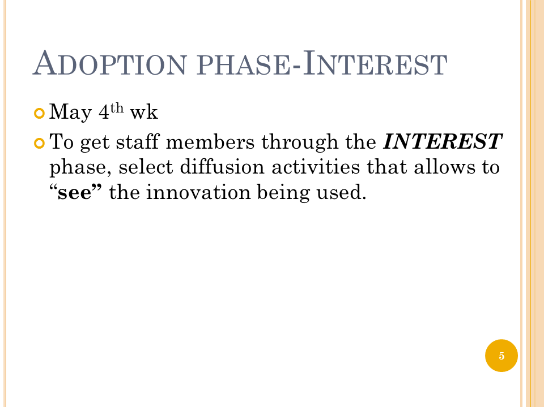
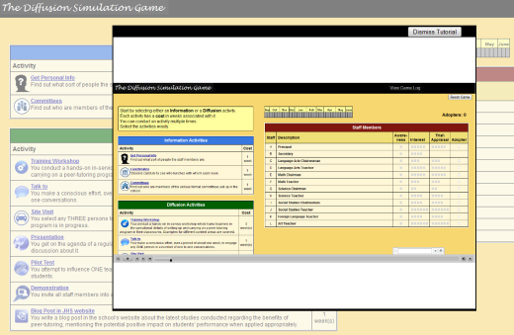
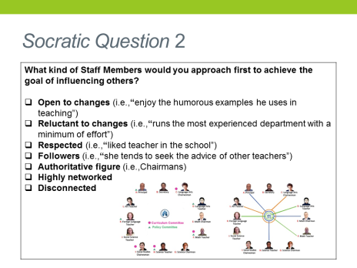
Iterative Redesign Cycle of
Instructional Overlay
“Prompt”
  Problem: need customization
  Theory: Shute (2008)
2. “Video-based feedback”
  Goal: modeling + JIT hint
  Theory: Wouters (2008), Johnson & Rickel (1999)
  Problems: insufficient, late timing, cognitive overload
3. “Socratic quiz”
  Goal: build background knowledge
  Theory: De Jong (1998), Merrill (2002)
  Problems: forgets obtained knowledge and uses random strategies
Notes:
Elaborate “Theoretical framework”

Slide 32
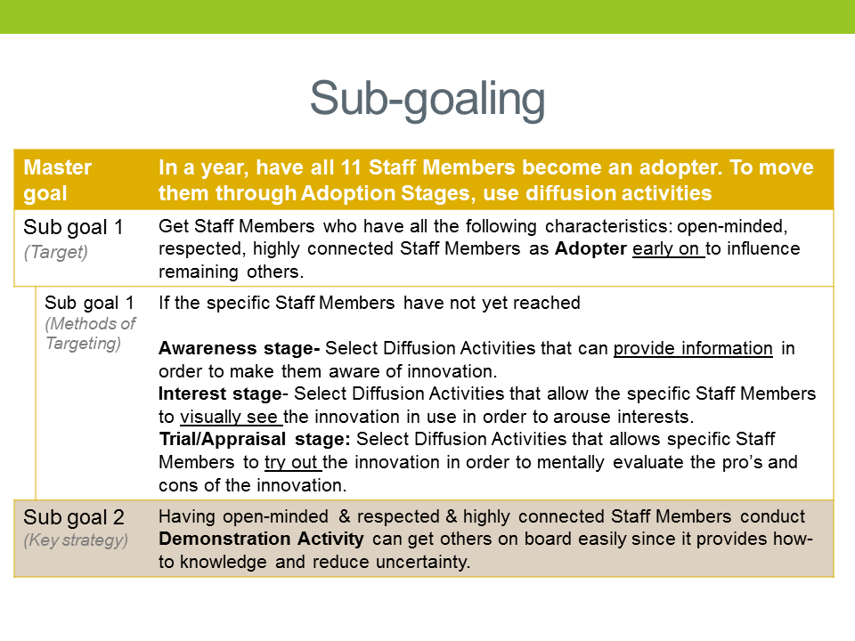
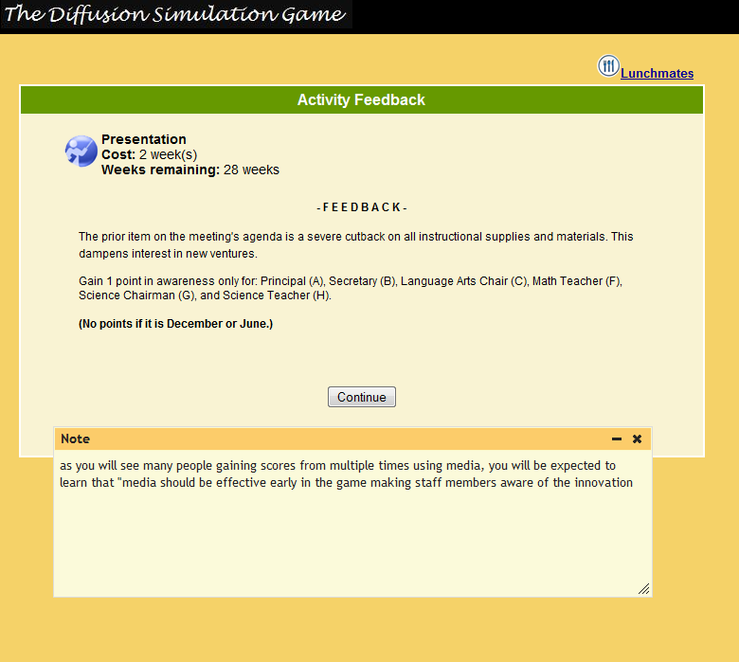
Iterative Redesign Cycle of
Instructional Overlay
4. “Sub-goaling”
  Goal: Guide direction
  Theory: Catrambone (1998)
  Problem: insufficient on its own
5. “Instructional/Corrective Feedback”
  Goal: Correct confirmation bias
  Theory: Moreno (2004), Bos (2001)

Slide 33
Proposed Instructional Overlay Strategies in Complex Games
Timing | Sequence | Reasons
Before the game | Socratic Quiz | Schema building
Before the game | Game Modeling | Enactive/ Performative knowledge building
Provided along with game feedback | Instructional Feedback | Correction of bias
Always appear in the game | Sub-goaling | Prevent random strategies

Slide 34
Evaluation of Instructional Overlay in game-based learning
Comparison | Interventions | Dependent Variables
Treatment group | Socratic Quiz | Game Score
 | Game Modeling
 | Instructional Feedback
 |  | Game Theory Learning Test
 | Sub-goaling
Control Group | Game Modeling
 |  | Game Perception Survey
 | Repeated game play (twice)

Slide 35

Rod’s Agricultural Version for
Prof. Bill Weeks at Oklahoma State Univ.
Client/Collaborator
Dr. William Weeks, Oklahoma State University
Goals
To create a new scenario for the DSG that is more relevant to Dr. Weeks’ students
To test our implementation of MVC, which is intended to separate content from game engine
Changes | Original version | New version
Setting | James Whitcomb Riley Junior High School | Stillwater Farmers’ Market Association
Innovation | Peer tutoring | Organic practice
NPCs | Faculty and staff | Local farmers
Most changes were textual:
New descriptions of setting and innovation
New descriptions of non-player characters (NPCs)
Revised descriptions of some activities
Revised feedback for some outcomes
Results
MVC was imperfectly implemented but can be fixed (a good learning experience.
Some NPC descriptions might be revised to better suggest adopter type.

Slide 36
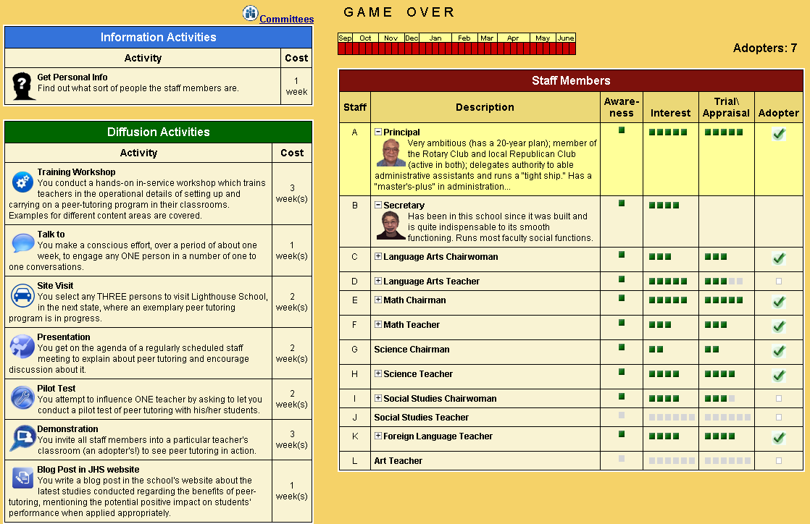
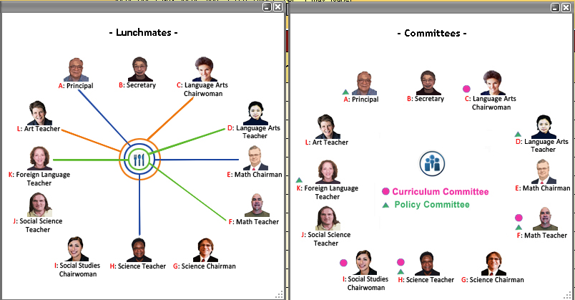
Miguel’s Version for Prof. Bude Su at CSU Monterey Bay & Beijing
Student | Pre - Test | Post - Test
agent1 | 4.99 | 4.66
agent3 | 5.49 | 9
agent5 | 5.32 | 10.33
agent6 | 3.99 | 6.66
agent7 | 4.33 | 10
agent10 | 6.33 | 11
agent6 | 7.32 | 6.32
agent17 | 6.99 | 7.33
agent18 | 5.33 | 6.33
FPS | 5.96 | 11.66
TRENT | 7 | 7
JM | 4 | 8.33
Average | 5.588 | 8.218
Standard Dev. | 1.160 | 2.182
Paired t-test results:
t = 3.64
df = 11
Two-tailed P value = 0.0039
Results are considered
statistically significant.

Slide 37
You can play too!
Production version v.1:
http://www.indiana.edu/~istdemo/
New version v.2 (beta):
http://www.indiana.edu/~simgame/beta/dsg.html
Send comments, questions, feedback to
simgame@indiana.edu

Slide 38
References
Corry, M. D., Frick, T. W. & Hansen, L. (1997). User-centered design and usability testing of a Web site: An illustrative case study. Educational Technology Research and Development, 45(4), 65-76.
Frick, T., Myers, R., Thompson, K., & York, S. (2008). New Ways to Measure Systemic Change: Map & Analyze Patterns & Structures Across Time. AECT Summer Research Symposium. Bloomington, Indiana. Retrieved January 23, 2009 from http://www.indiana.edu/~tedfrick/MAPSATsummerAECTsymposiumFinal.pdf
Reigeluth, C. M., & Frick, T. W. (1999). Formative research: A methodology for creating and improving design theories. In C. M. Reigeluth (Ed.), Instructional design theories and models: A new paradigm of instructional theory (Vol. II, pp. 633-651). Hillsdale, NJ: Lawrence Erlbaum Associates.
Rogers, E. M. (1995). Elements of Diffusion in E. M. Rogers, Diffusion of Innovations 4th Ed. New York: The Free Press
Shneiderman, B., & Plaisant, C. (2005). Designing the user interface: Strategies for effective human-computer interaction. Boston, MA: Pearson Education
Van Merriënboer, J. J. G., & Kirschner, P. A. (2007). Ten steps to complex learning: A systematic approach to Four-Component Instructional Design. Mahwah, NJ: Lawrence Erlbaum Associates
Walker, D. (2006). Toward productive design studies. In J. van den Akker, K. Gravemeijer, S. McKenney & N. Nieveen (Eds.), Educational design research (pp. 9-18). New York: Routledge

Slide 39
Questions

