Slide 1
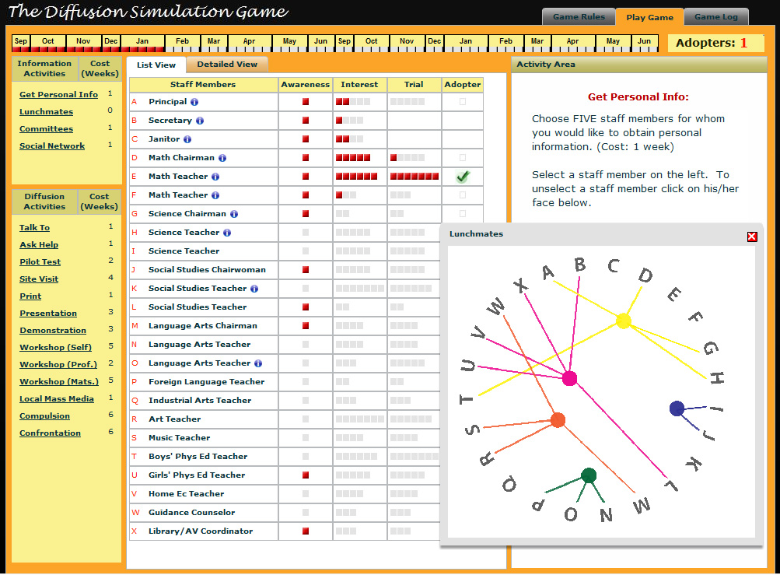
Analyzing Interaction Patterns
to Verify a Simulation/Game Model
Rod Myers
Ph.D. candidate
Instructional Systems Technology
Indiana University-Bloomington
Dissertation Chair:
Dr. Ted Frick
Professor and Department Chair
Instructional Systems Technology
Indiana University-Bloomington

Slide 2
Analyzing Interaction Patterns to Verify a Simulation/Game Model
Problem
When games and simulations represent real-world systems and processes, designers must consider the degree of fidelity appropriate for various elements, including the external representation, the underlying model, and the interaction of the components (Alessi & Trollip, 2001; Reigeluth & Schwartz, 1989).
Practical question
How do we know we built it right?

Slide 3



Analyzing Interaction Patterns to Verify a Simulation/Game Model
SimCity
Conceptual Model
“capitalistic, land-value ecology”
if(crimerate==bad)
{mayorapproval--}
Real-World
Phenomenon
Computational Model

Slide 4
Analyzing Interaction Patterns to Verify a Simulation/Game Model
SimCity
Conceptual Model
Validation
Did we build the right model?
“capitalistic, land-value ecology”
Verification
Did we build the model right?
if(crimerate==bad)
{mayorapproval--}
Real-World
Phenomenon
Computational Model

Slide 5
Analyzing Interaction Patterns to Verify a Simulation/Game Model
Purpose
Formalize a method of verifying the accuracy of a simulation/game’s computational model
Research Questions
Is the proposed method effective in verifying the accuracy of computational models created for simulations and games?
What does the proposed method contribute that is not available through related methods?
What improvements can be made to the proposed method?

Slide 6
Analyzing Interaction Patterns to Verify a Simulation/Game Model
Research Design
A single-case study (Yin, 2009) within the paradigm of educational design research (van den Akker et al., 2006)
Description of the Case
The Diffusion Simulation Game (DSG)
Original board game (1975-76) → online (2002)
Role/Context: Change agent at a junior high school
Objective: Persuade as many of the 22 staff members as possible to adopt peer tutoring.
Learning Objective: Understand and apply the theory of the diffusion of innovations, primarily Rogers (1962, 2003).

Slide 7
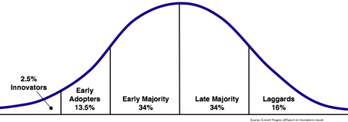
Analyzing Interaction Patterns to Verify a Simulation/Game Model
Case: The Diffusion Simulation Game (DSG)
Rogers’ Diffusion of Innovations Model
Innovation Decision Process
  Knowledge → Persuasion → Decision → Implementation → Confirmation
  DSG: Awareness → Interest → Trial → Adoption
Adopter Types
Innovator | Early Adopter | Early Majority | Late Majority | Laggard

Slide 8

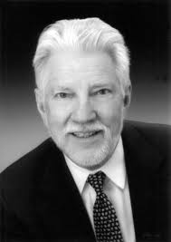
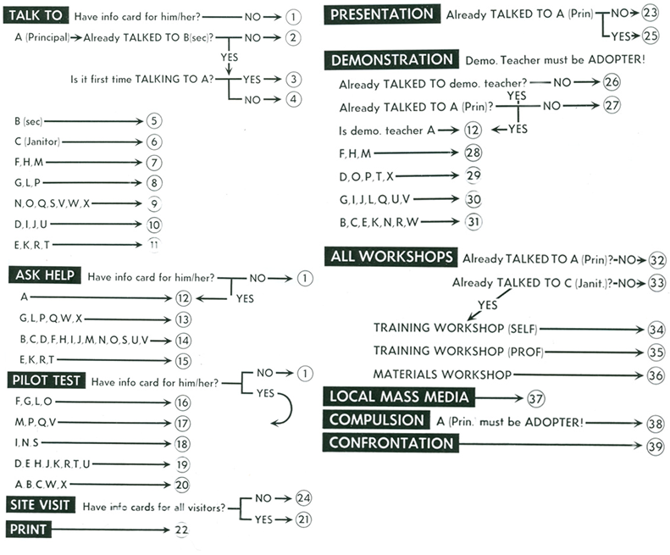
Analyzing Interaction Patterns to Verify a Simulation/Game Model
Diffusion Simulation Game
Conceptual Model
if(awareness>1)
{interest++}
Real-World
Phenomenon
Computational Model

Slide 9
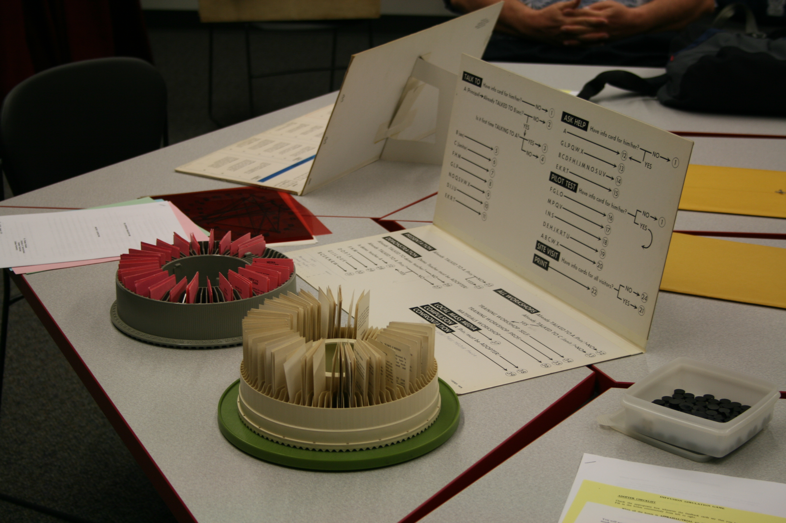
Analyzing Interaction Patterns to Verify a Simulation/Game Model
DSG Board Game

Slide 10
Analyzing Interaction Patterns to Verify a Simulation/Game Model
Main components of the game
Number of Adopters
2 Year
Calendar
Adoption Phase
Activities
Staff Members & Personal Info

Slide 11
Analyzing Interaction Patterns to Verify a Simulation/Game Model
Activities
Information Activities
Diffusion Activities
Get Personal Information
View diagrams of interpersonal relationships
  Lunchmates
  Committee members
  Social networks
Talk To
Ask Help
Pilot Test
Site Visit
Print
Presentation
Demonstration
Workshops (3 types)
Local Mass Media
Compulsion
Confrontation

Slide 12
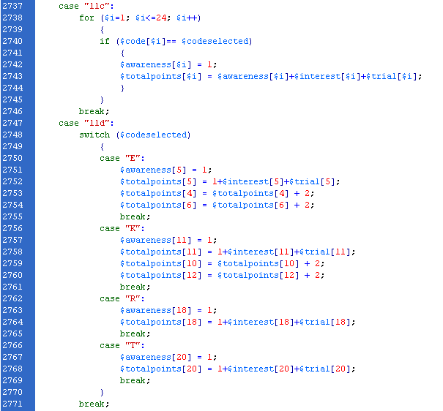
Analyzing Interaction Patterns to Verify a Simulation/Game Model
Computational Model

Slide 13
Analyzing Interaction Patterns to Verify a Simulation/Game Model
MAPSAT: Map and Analyze Patterns & Structures Across Time
Analysis of Patterns in Configurations
  Maps of system structures
Analysis of Patterns in Time
  Maps of temporal relations of categories within classifications (system dynamics)
  Temporal maps are queried for sequences of observed events, resulting in probability estimates for patterns

Slide 14
Analyzing Interaction Patterns to Verify a Simulation/Game Model
MAPSAT: Map and Analyze Patterns & Structures Across Time
Quantitative methods
  General linear models approach assumes linear, additive models
  Variables (components) are measured separately and statistics are used to relate measures (e.g., correlation, multiple and logistic regression, path analysis, hierarchical linear models, structural equations)
Qualitative methods
  Rich details of individual cases, including patterns
  Lack of generalizability
Mixed methods
  Utilize strengths of both approaches

Slide 15
Analyzing Interaction Patterns to Verify a Simulation/Game Model
MAPSAT: Map and Analyze Patterns & Structures Across Time
With MAPSAT we index relations directly and specifically
  ‘Map relations’ is a better way to say this, since we do not measure in the usual sense
  Relations are specifically indexed
  No function is assumed for representing relations (e.g. a linear, additive model)

Slide 16
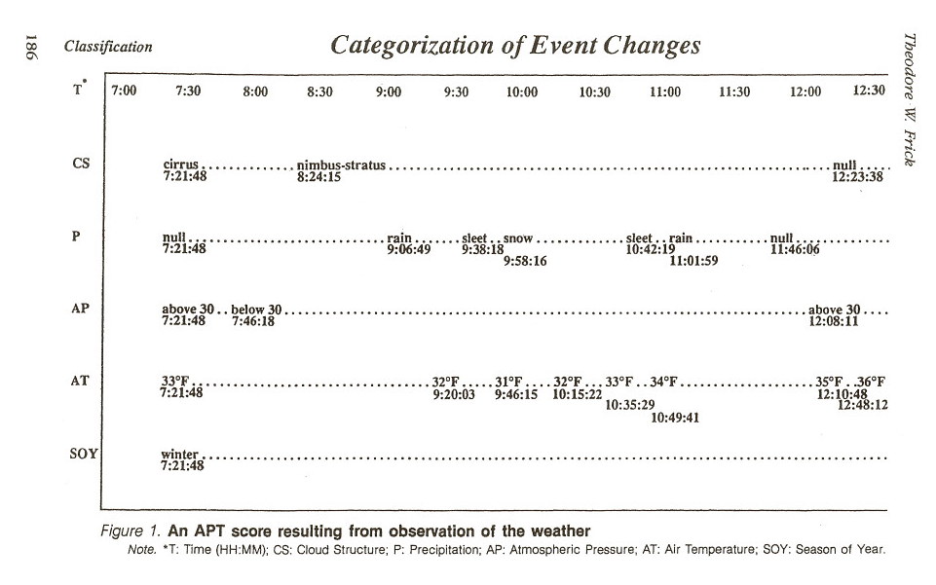
Analyzing Interaction Patterns to Verify a Simulation/Game Model
MAPSAT: Analysis of Patterns in Time (APT)

Slide 17
Analyzing Interaction Patterns to Verify a Simulation/Game Model
Pilot Study
Enfield, J., Myers, R. D., Lara, M., & Frick, T. W. (2011). Innovation diffusion: Assessment of strategies within the DIFFUSION SIMULATION GAME. Simulation & Gaming. Advance online publication. doi: 10.1177/1046878111408024
Limitations
Historical data captured for game state, not analysis
Lacking critical data regarding…
  staff member’s adoption phase at a given time
  points awarded per staff member for a turn

Slide 18
“Replaying” the Games
Analyzing Interaction Patterns
to Verify a Simulation/Game Model
Modify original code:
  Use data from original games as parameters to calculate results
  Store data that were lacking in first study
Challenges
  Minor improvements to code over time
  Ambiguity of certain results
    Duplicate feedback text for different results
    Write function to try all possible combinations

Slide 19
APT for Model Verification
Analyzing Interaction Patterns
to Verify a Simulation/Game Model
Formulate the conceptual model as patterns of temporal events
Map those events to actions that may be taken in the simulation
Identify the data associated with those actions required for analysis (classifications and categories)
Collect the data
Query the data for patterns of interest
Calculate the probability of these patterns resulting in successful gameplay

Slide 20
Predicted Successful Strategies
Analyzing Interaction Patterns
to Verify a Simulation/Game Model
Strategy 1:
Target earlier adopters and opinion leaders early in the game to work toward critical mass
  First 15 turns
  Innovators, Early Adopters, Opinion Leaders
  F G H L M P X

Slide 21
Analyzing Interaction Patterns
to Verify a Simulation/Game Model
Predicted Successful Strategies
Strategy 2:
Use Personal Information and Talk To
  Establish empathy and rapport
  Understand client’s needs, values, beliefs

Slide 22
Predicted Successful Strategies
Analyzing Interaction Patterns
to Verify a Simulation/Game Model
Strategy 3:
Use Local Mass Media and Print to gain points in Awareness and Interest among earlier adopters
  They pay more attention to external sources of innovation
  Included Print because earlier adopters are more homophilous to the change agent
  Innovators, Early Adopters
  F G L M P X

Slide 23
Predicted Successful Strategies
Analyzing Interaction Patterns
to Verify a Simulation/Game Model
Strategy 4:
Use Presentation to gain points in Awareness and Interest
  More likely to influence earlier adopters due to homophily with change agent

Slide 24
Predicted Successful Strategies
Analyzing Interaction Patterns
to Verify a Simulation/Game Model
Strategy 5:
Use Demonstration, especially by an opinion leader, to gain points in Interest for other potential adopters
  Provide how-to knowledge and reduce uncertainty
  Respected peer is best source
  Opinion Leaders
  F H M

Slide 25
Predicted Successful Strategies
Analyzing Interaction Patterns
to Verify a Simulation/Game Model
Strategy 6:
Use Site Visit to gain points in Interest and move into Trial
  See innovation in use on a larger scale than Demonstration
  Generate discussion with peers

Slide 26
Predicted Successful Strategies
Analyzing Interaction Patterns
to Verify a Simulation/Game Model
Strategy 7:
Use Pilot Test to gain additional points for those with some Interest or in Trial
  Trial on a limited basis to further reduce uncertainty
  Trial by peers can serve as vicarious trial for later adopters, so opinion leaders and highly connected individuals are most effective
  Opinion Leaders, Highly Connected
  F G H J L M V W

Slide 27
Predicted Successful Strategies
Analyzing Interaction Patterns
to Verify a Simulation/Game Model
Strategy 8:
Target highly connected individuals to gain points in Interest among later adopters in their social networks
  Interpersonal channels are more effective in later stages of innovation-decision process
  Highly Connected
  F G H J L V W

Slide 28
Predicted Successful Strategies
Analyzing Interaction Patterns
to Verify a Simulation/Game Model
Strategy 9:
Use Training Workshop (Self) and Materials Workshop to gain points in Trial
  How-to knowledge is essential when someone becomes willing to try an innovation
  Help to reduce uncertainty and increase confidence

Slide 29
Examples of Predicted Successful Strategies
Analyzing Interaction Patterns
to Verify a Simulation/Game Model
Strategy 1:
Target earlier adopters and opinion leaders early in the game to work toward critical mass
  First 15 turns
  Innovators, Early Adopters, Opinion Leaders
  F G H L M P X
Strategy 9:
Use Training Workshop (Self) and Materials Workshop to gain points in Trial
  How-to knowledge is essential when someone becomes willing to try an innovation
  Help to reduce uncertainty and increase confidence

Slide 30
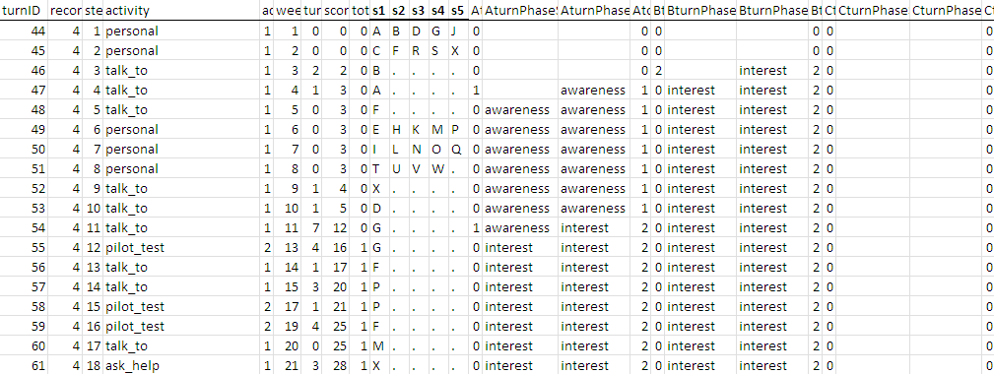
Analyzing Interaction Patterns to Verify a Simulation/Game Model
Variables
Activities
  Cost (in weeks)
Staff members
  Adopter type
  Adoption phase
Game metrics
  Adoption points
  Number of adopters

Slide 31
Calculating Strategy Scores
Analyzing Interaction Patterns
to Verify a Simulation/Game Model
For every turn (n=107,294), calculate a score for each strategy; sum these for a Total Strategy score.
For every game (n=2,361), sum these scores.
Divide these sums by the number of turns taken in the game for a relative frequency score.

Slide 32
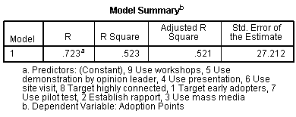
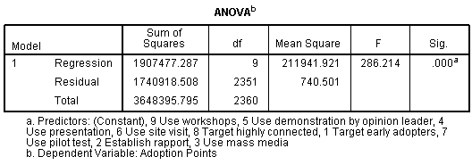
Preliminary Results
Analyzing Interaction Patterns
to Verify a Simulation/Game Model

Slide 33
Preliminary Results
Analyzing Interaction Patterns
to Verify a Simulation/Game Model
 |  | Adoption Points | 1 Target early adopters | 2 Establish rapport | 3 Use mass media | 4 Use presentation | 5 Use demonstration by opinion leader | 6 Use site visit | 7 Use pilot test | 8 Target highly connected | 9 Use workshops
Adoption Points | Pearson Correlation | 1 | .288 | .020 | .433 | -.006 | .149 | .323 | -.441 | -.231 | .469
 | Sig. (2-tailed) |  | .000 | .335 | .000 | .776 | .000 | .000 | .000 | .000 | .000
1 Target early adopters | Pearson Correlation |  | 1 | -.026 | .116 | -.026 | .099 | .131 | -.067 | -.101 | .285
 | Sig. (2-tailed) |  |  | .206 | .000 | .206 | .000 | .000 | .001 | .000 | .000
2 Establish rapport | Pearson Correlation |  |  | 1 | -.471 | -.262 | .059 | -.314 | -.083 | .156 | -.220
 | Sig. (2-tailed) |  |  |  | .000 | .000 | .004 | .000 | .000 | .000 | .000
3 Use mass media | Pearson Correlation |  |  |  | 1 | .017 | -.142 | .383 | -.369 | -.295 | .276
 | Sig. (2-tailed) |  |  |  |  | .410 | .000 | .000 | .000 | .000 | .000
4 Use presentation | Pearson Correlation |  |  |  |  | 1 | -.052 | -.019 | -.007 | .036 | .085
 | Sig. (2-tailed) |  |  |  |  |  | .011 | .366 | .733 | .080 | .000
5 Use demonstration by opinion leader | Pearson Correlation |  |  |  |  |  | 1 | -.085 | .132 | .181 | -.025
 | Sig. (2-tailed) |  |  |  |  |  |  | .000 | .000 | .000 | .224
6 Use site visit | Pearson Correlation |  |  |  |  |  |  | 1 | -.215 | -.207 | .204
 | Sig. (2-tailed) |  |  |  |  |  |  |  | .000 | .000 | .000
7 Use pilot test | Pearson Correlation |  |  |  |  |  |  |  | 1 | .307 | -.261
 | Sig. (2-tailed) |  |  |  |  |  |  |  |  | .000 | .000
8 Target highly connected | Pearson Correlation |  |  |  |  |  |  |  |  | 1 | -.192
 | Sig. (2-tailed) |  |  |  |  |  |  |  |  |  | .000
9 Use workshops | Pearson Correlation |  |  |  |  |  |  |  |  |  | 1
 | Sig. (2-tailed)

Slide 34
Next Steps
Analyzing Interaction Patterns
to Verify a Simulation/Game Model
Have strategies evaluated by experts
Run simulated games using these strategies
Finish MAPSAT APT software to query patterns

Slide 35
Questions?
Rod Myers – rodmyers@indiana.edu
Instructional Systems Technology
Indiana University-Bloomington
http://education.indiana.edu/~ist/
Play the Diffusion Simulation Game
http://www.indiana.edu/~istdemo
Learn more about MAPSAT
http://www.indiana.edu/~aptfrick

